Slide 1
Stellar Classification with Multi-Class Models
Comparing different multi-class classification models on the stellar classification dataset.

Slide 2
Research Question
Which of several different multi-class classification models, such as random forest or naive bayes, performs best when classifying stars based on special characteristics?

Slide 3
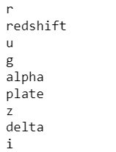
The Dataset: Stellar Classification
General
Features & Labels
Size: 100,000
Features: 17
Class labels: 3
Labels: galaxy, star, quasar object
Features: 8 are ID, left with 9 numerical features

Slide 4
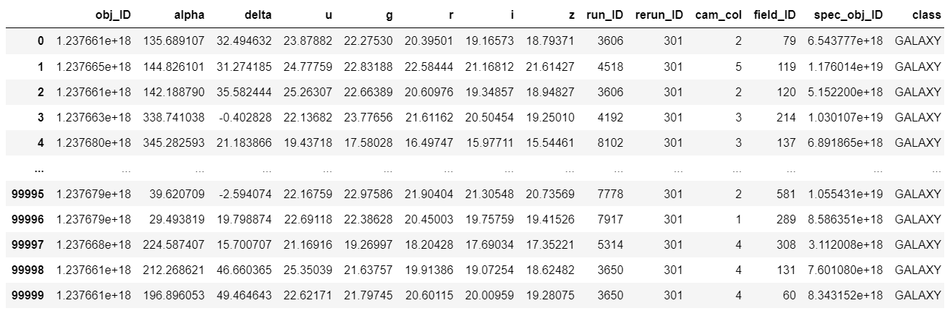
The Dataset: Stellar Classification

Slide 5
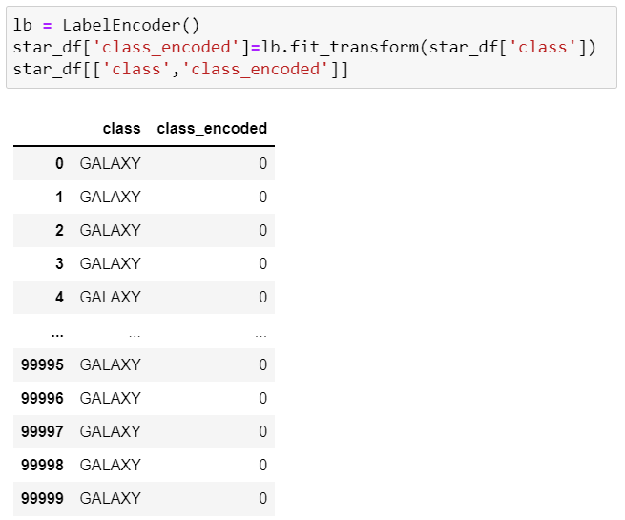
Data Preprocessing
mostly clean data, no null values and data was of correct type
encoded the classes
removed ID features

Slide 6
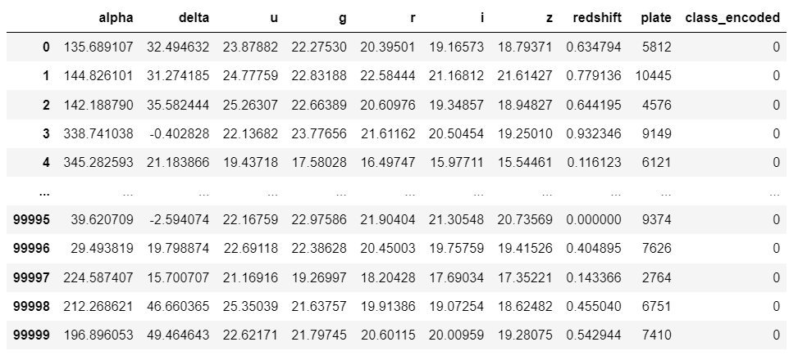
The Dataset: Stellar Classification Cleaned

Slide 7
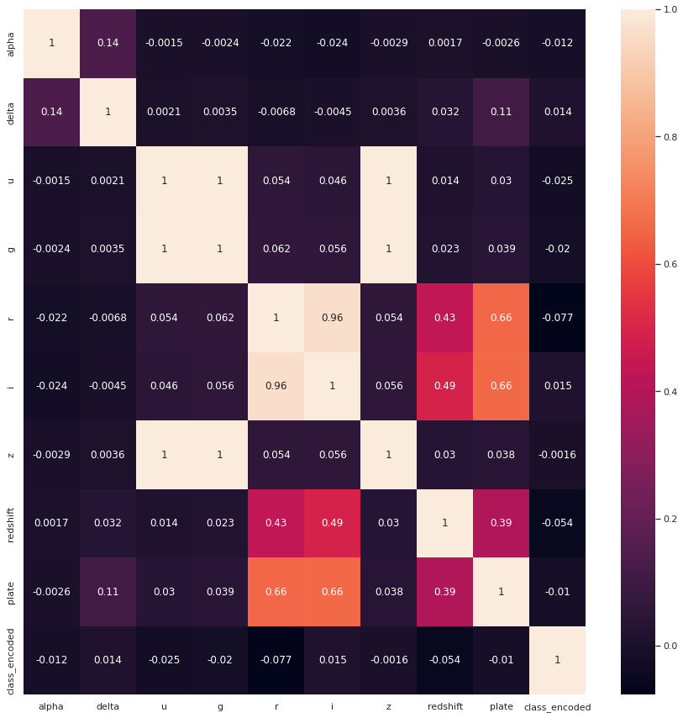
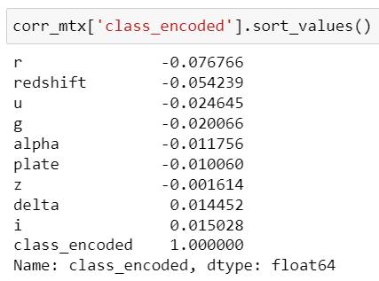
Data Exploration

Slide 8
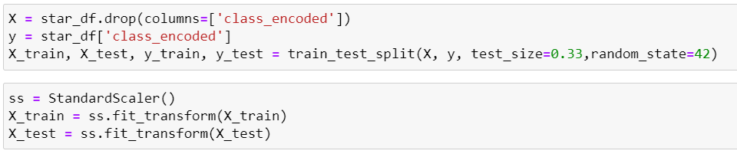
Data Splitting & Scaling
basic train_test_split, test size = 0.33
67,000 train, 33,000 test
used StandardScaler()

Slide 9
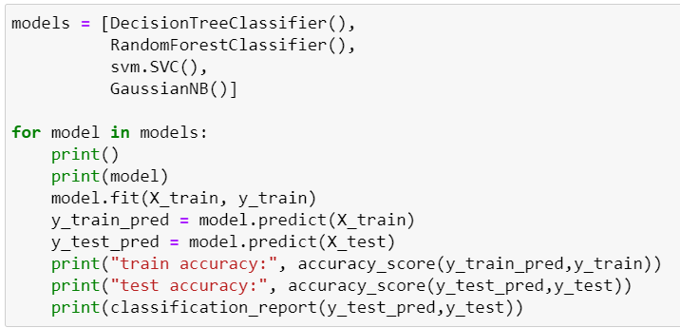
Model Selection
deciding between multiple possible models: decision tree, random forest, SVM, Gaussian naive bayes

Slide 10
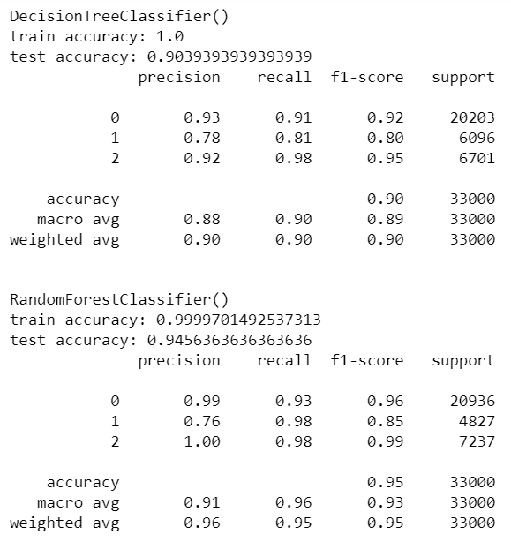
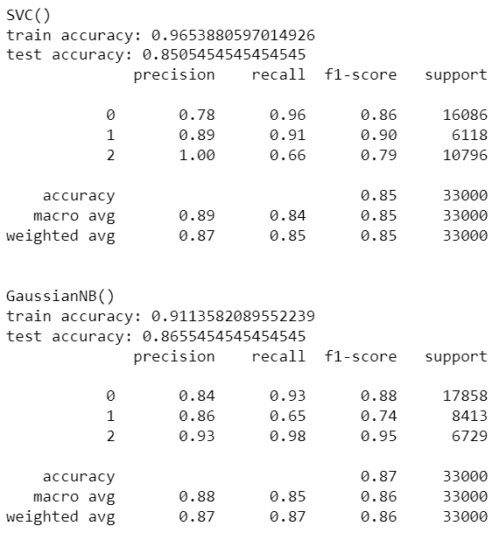
Model Selection

Slide 11
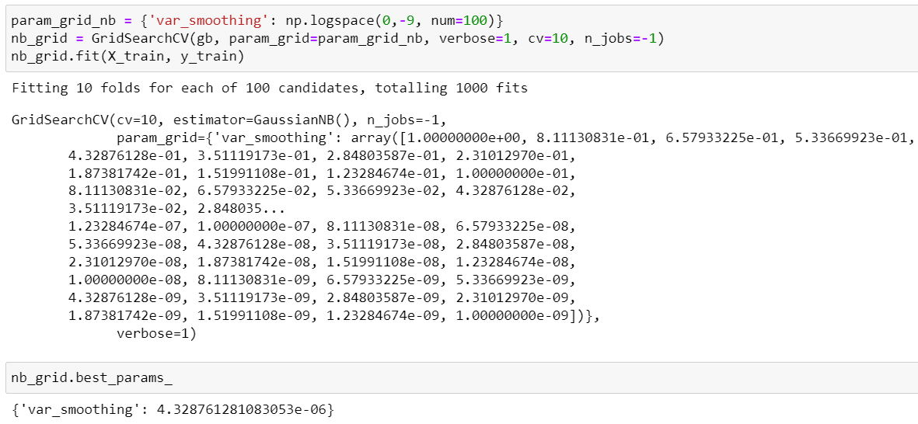
Hyperparameter Tuning

Slide 12
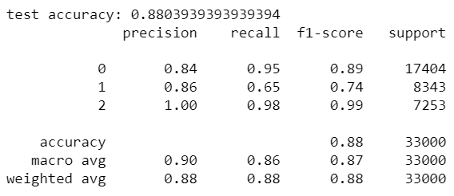
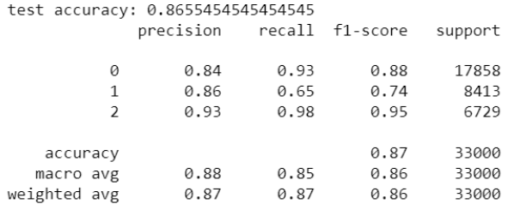
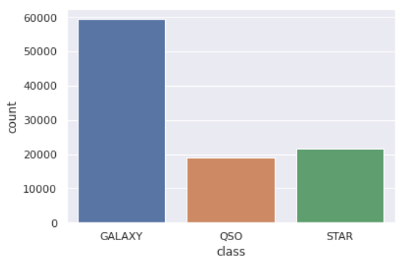
Final Model and Conclusions
Other Possible Approaches:
tuned the RandomForest model
resampled data since there was an imbalance

